Slide 1

Capstone Project – 4 Un Supervised Netflix Movies And TV Shows Clustering by Sai Narasimha Charan Thulasi

Slide 2
Project Summary
The entertainment industry is highly competitive, and success is dependent on various factors, including genre, rating, production budget, cast, and more. In this context, a study was conducted to understand the factors influencing the popularity of movies and TV shows on Netflix. The study used a dataset containing around 12 variables to cluster the movies and TV shows based on their popularity and audience preferences. The first step in the analysis involved data wrangling, where missing values were handled, and unique values were checked. The study identified that there were 2389 missing values for the 'director' column, 718 for the 'cast' column, 507 for the 'country' column, and 10 for the 'date_added' column. These missing values were removed by dropping the corresponding rows.

Slide 3
Next, the study performed exploratory data analysis (EDA). The number of movies on Netflix is greater than the number of TV shows, with 5372 movies and 2398 TV shows currently available on the platform. The most common rating for TV shows is TV-MA, indicating that a significant portion of the TV shows available on Netflix are intended for adult audiences. Additionally, TV-MA is the most common rating for both movies and TV shows, suggesting that Netflix's content caters to a primarily adult demographic, with a focus on mature and potentially controversial themes. The years 2017 and 2018 had the highest number of movie releases, while 2020 had the highest number of TV show releases. The growth rate of movie releases on Netflix is significantly faster than that of TV shows.

Slide 4
Data Summary
show_id : Unique ID for every Movie / Tv Show
type : Identifier - A Movie or TV Show
title : Title of the Movie / Tv Show
director : Director of the Movie
cast : Actors involved in the movie / show
country : Country where the movie / show was produced

Slide 5
Data Summary
date_added : Date it was added on Netflix
release_year : Actual Releaseyear of the movie / show
rating : TV Rating of the movie / show
duration : Total Duration - in minutes or number of seasons
listed_in : Genere
Description : The Summary description

Slide 6
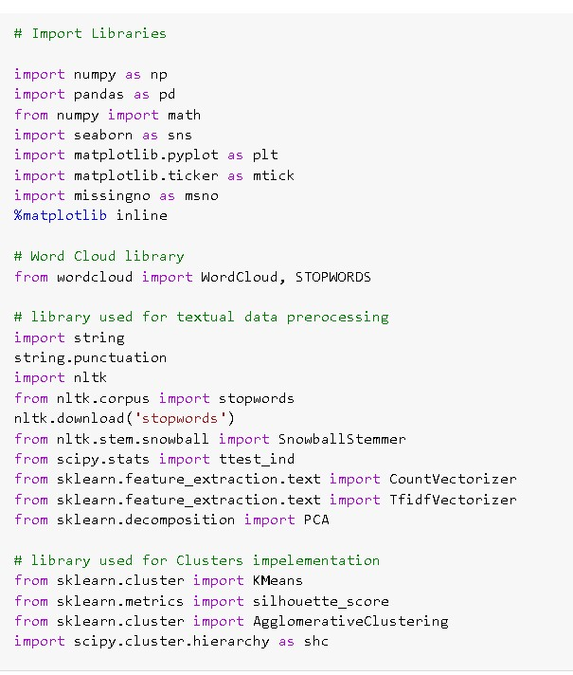
Import Libraries

Slide 7
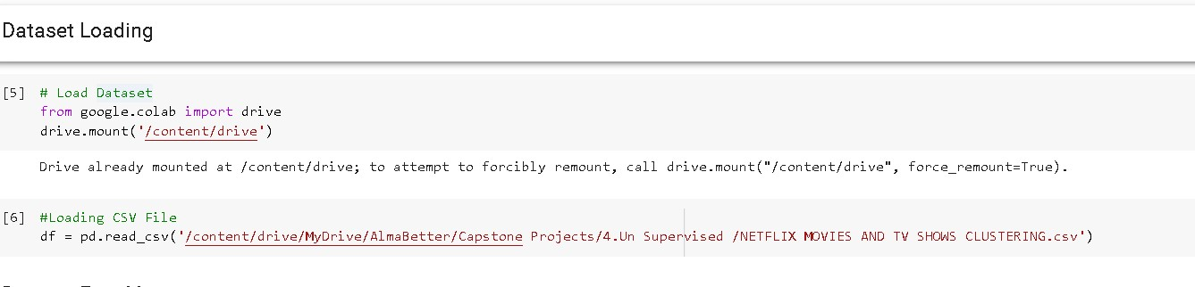
Dataset Loading
Mount the data set from the drive

Slide 8
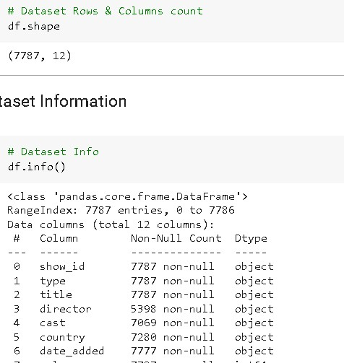
Dataset Rows & Columns count
Here we check the shape of the data set.
And the info of the dataset.

Slide 9
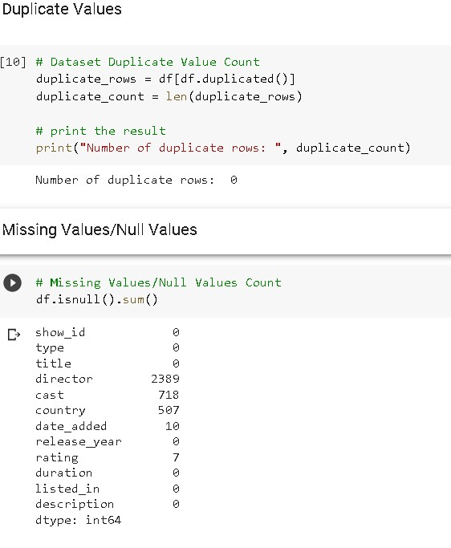
Duplicate Values & Null Values
Here check the duplicates of the data set.
And print the missing values or null values.

Slide 10
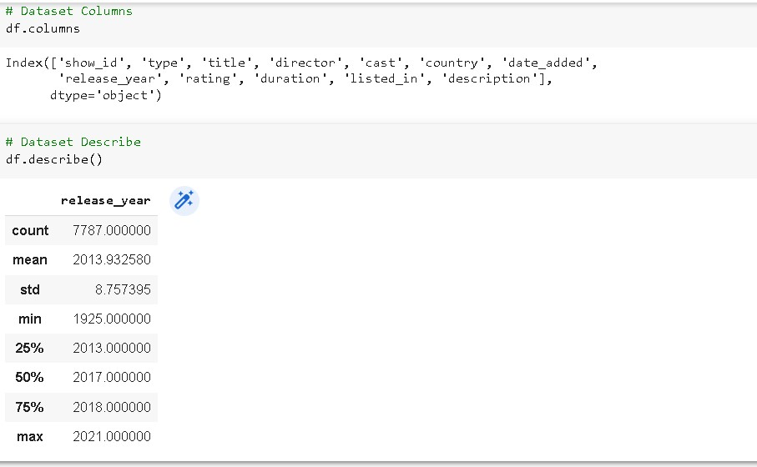
Understanding Your Variables
Here we print the columns of the data set.
And describe the DF.

Slide 11
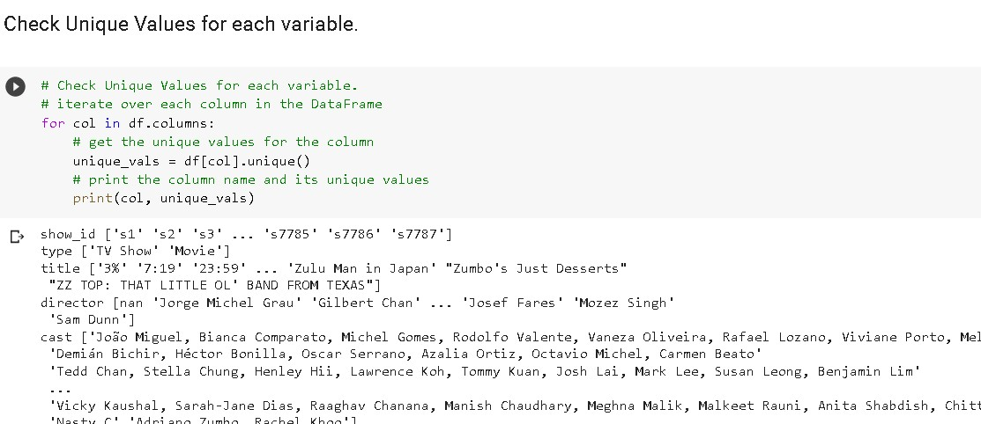
Check Unique Values

Slide 12
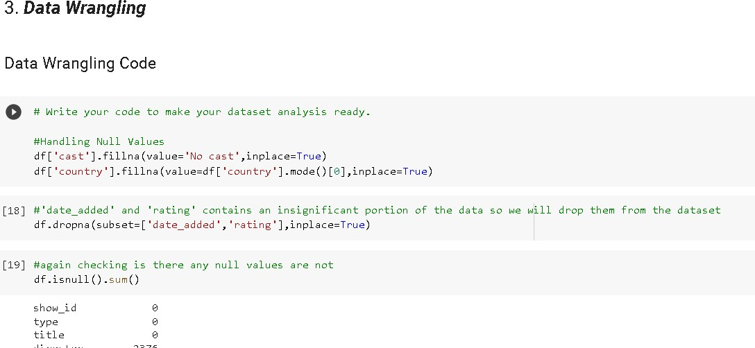
Data Wrangling
Data wrangling handling null values.
Insiginificant portion of the data so we will drop them from the dataset

Slide 13
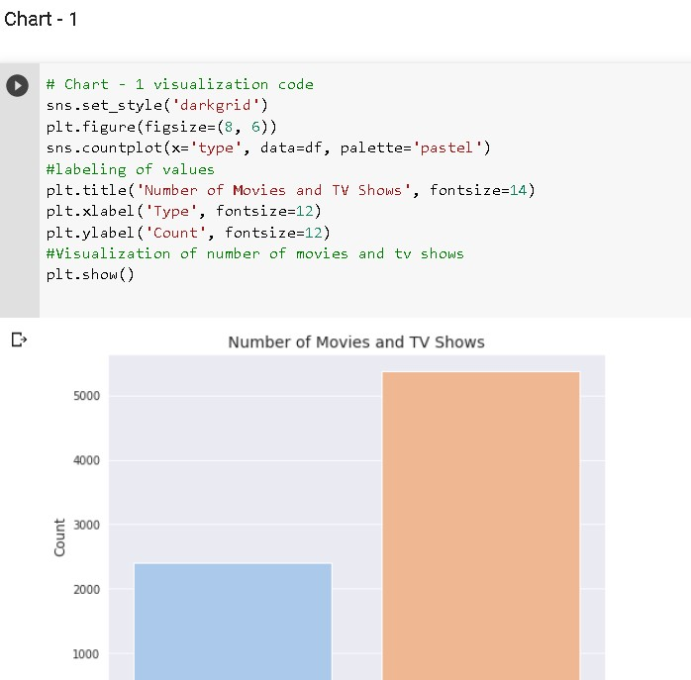
Data Vizualization, Storytelling & Experimenting with charts
Chart-1:
countplot (which is a type of bar chart) may be a good choice for visualizing categorical data, such as the number of movies and TV shows on Netflix.
The number of movies on Netflix is greater than the number of TV shows, with 5372 movies and 2398 TV shows currently available on the platform.

Slide 14
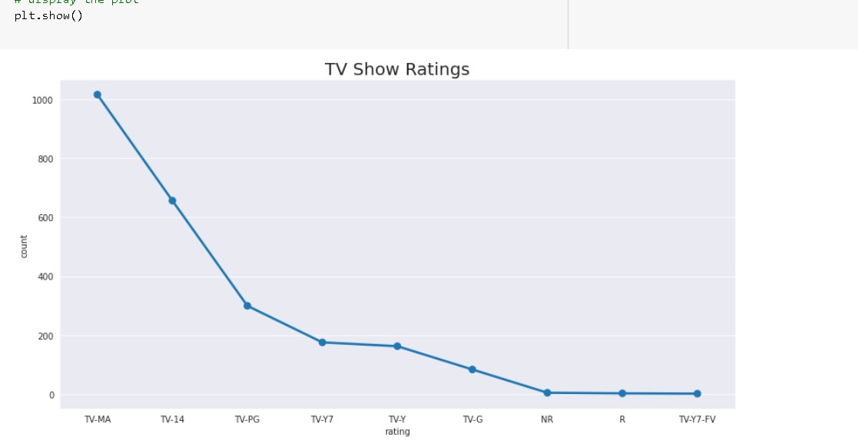
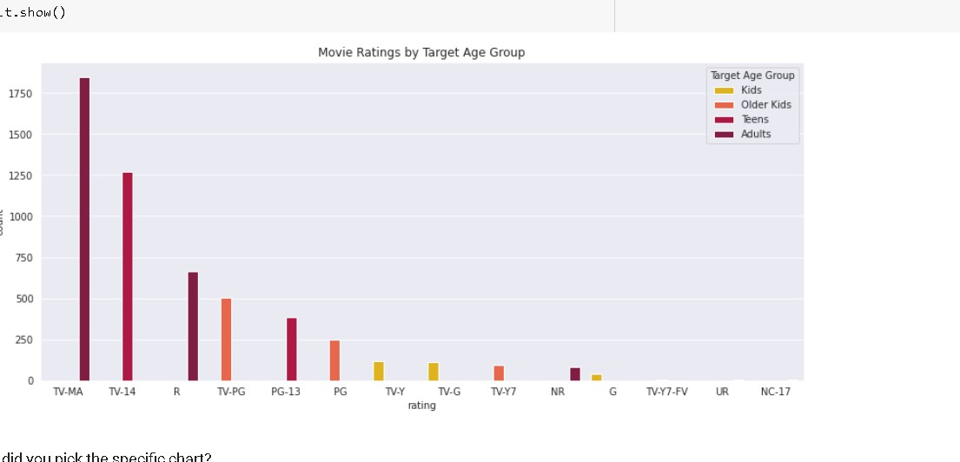
Data Vizualization, Storytelling & Experimenting with charts
Chart-2:
I chose this chart because it effectively shows the distribution of TV show ratings in a clear and concise manner.
According to the dataset, TV-MA is the most common rating for TV shows, with the highest number of occurrences in the 'rating' column.

Slide 15
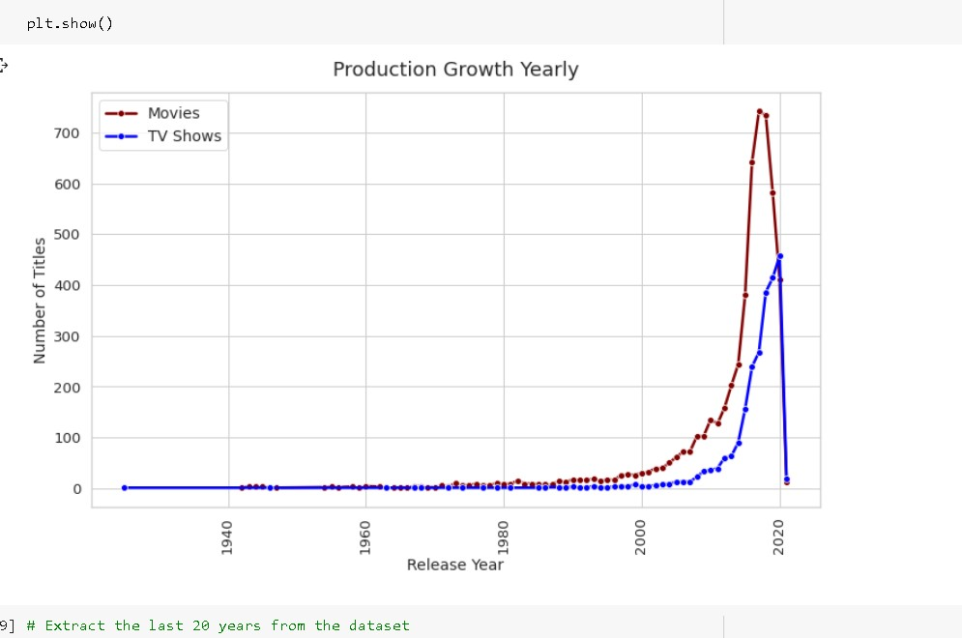
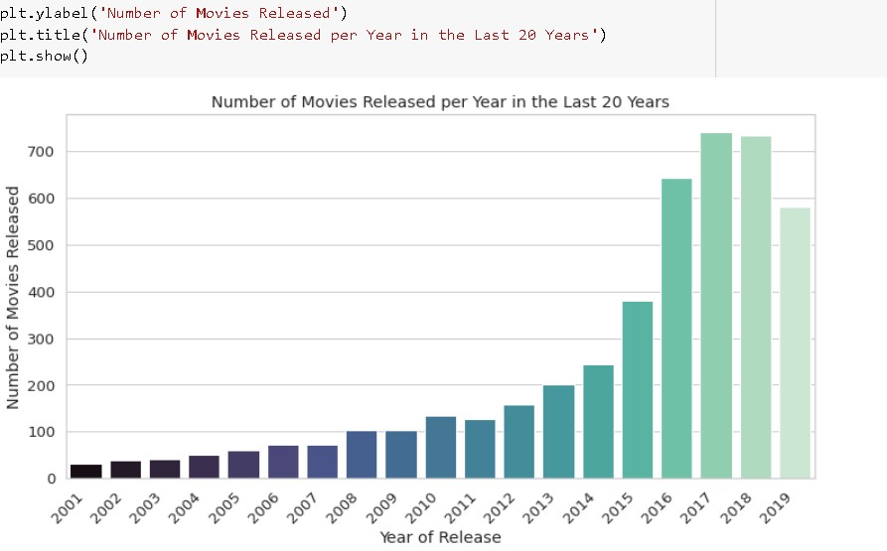
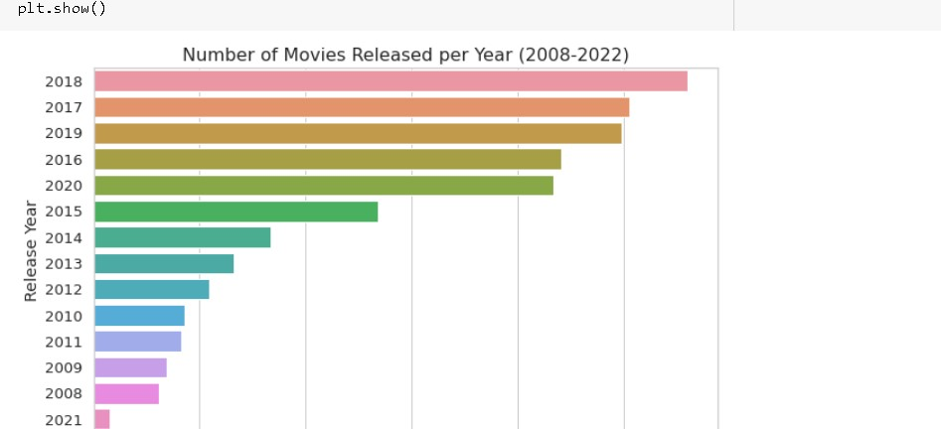
Data Vizualization, Storytelling & Experimenting with charts
Chart-3:
The best chart to use would be a line chart or a bar chart to display the number of movies and TV shows released per year from 2015 to 2020.
The years 2017 and 2018 had the highest number of movie releases, while 2020 had the highest number of TV show releases.

Slide 16
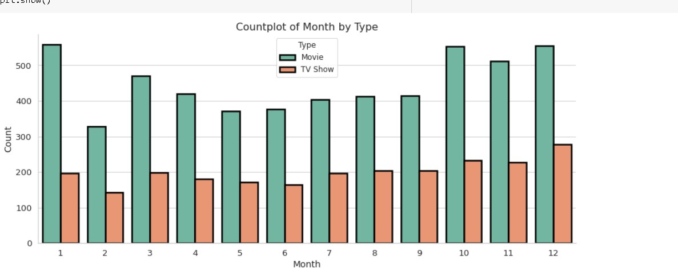
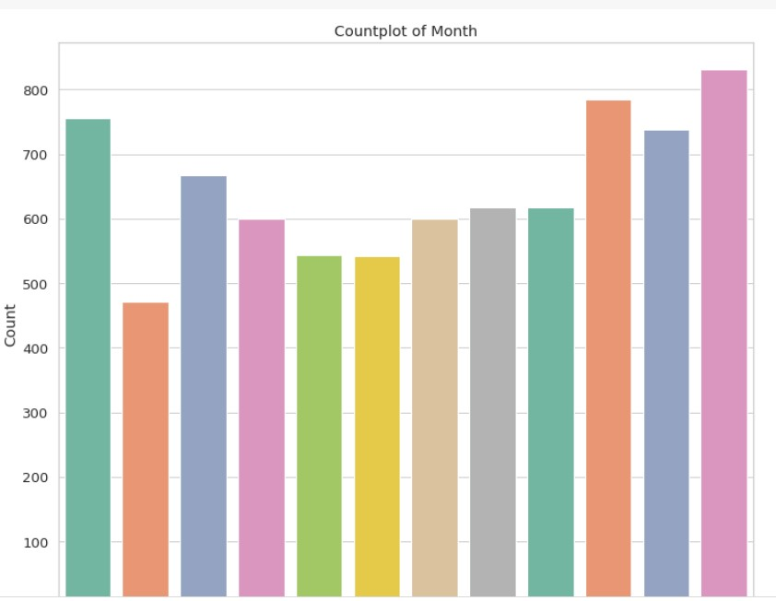
Data Vizualization, Storytelling & Experimenting with charts
Chart-4:
According to the countplot, it appears that Netflix adds the highest number of movies and TV shows during the period between October and January. This period seems to be the busiest time of year for Netflix in terms of adding new content to its platform.

Slide 17
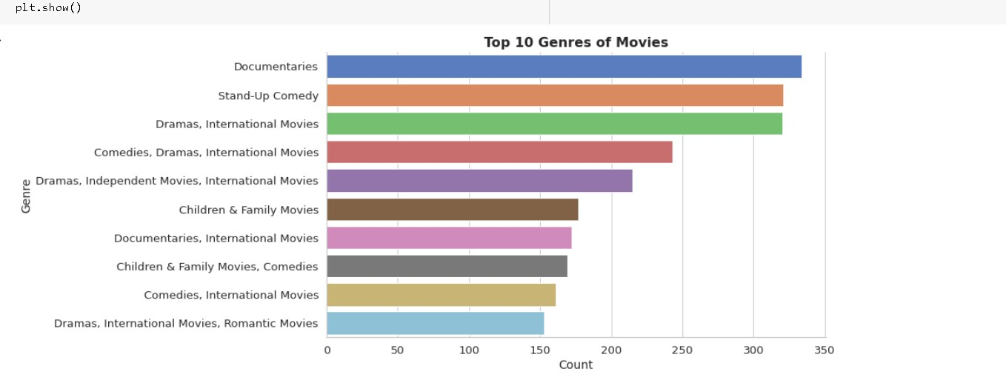
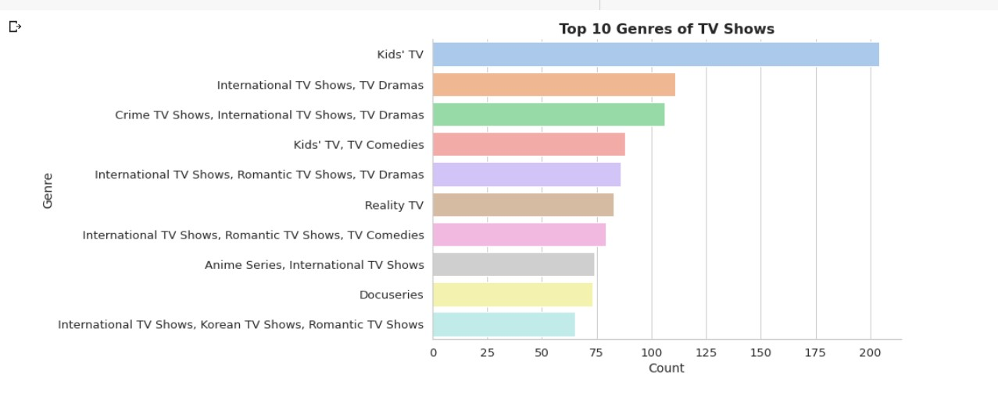
Data Vizualization, Storytelling & Experimenting with charts
Chart-5:
The count of netflix shows and tv shows.
Netflix offers a diverse range of TV show genres, each with its own unique flavor and appeal. However, one genre that stands out as a perennial favorite among viewers of all ages is kids TV.

Slide 18
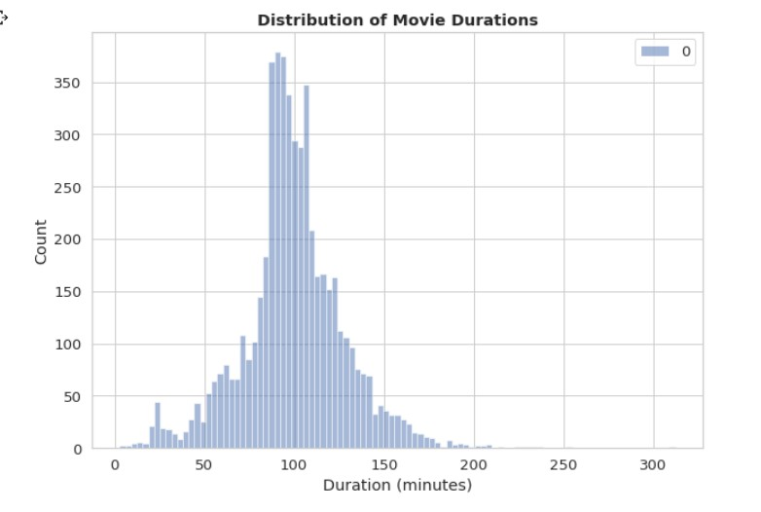
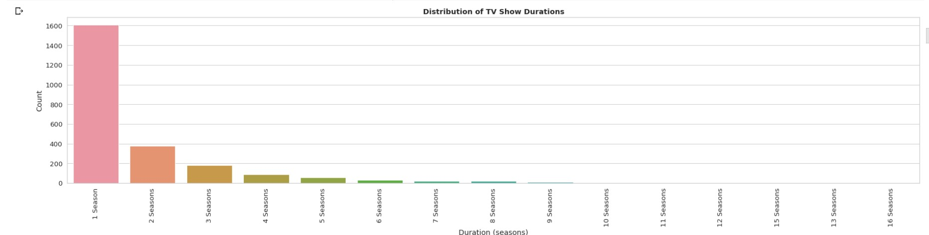
Data Vizualization, Storytelling & Experimenting with charts
Chart-6:
Movie duration and rating are two key factors that can influence a viewer's decision to watch a movie. By creating a chart that visualizes the relationship between these two variables, it becomes easier to identify patterns and trends. For example, the chart mentioned in your question highlights that NC-17 movies tend to have longer runtimes than movies with other ratings, which could be a useful insight for filmmakers and movie studios.

Slide 19
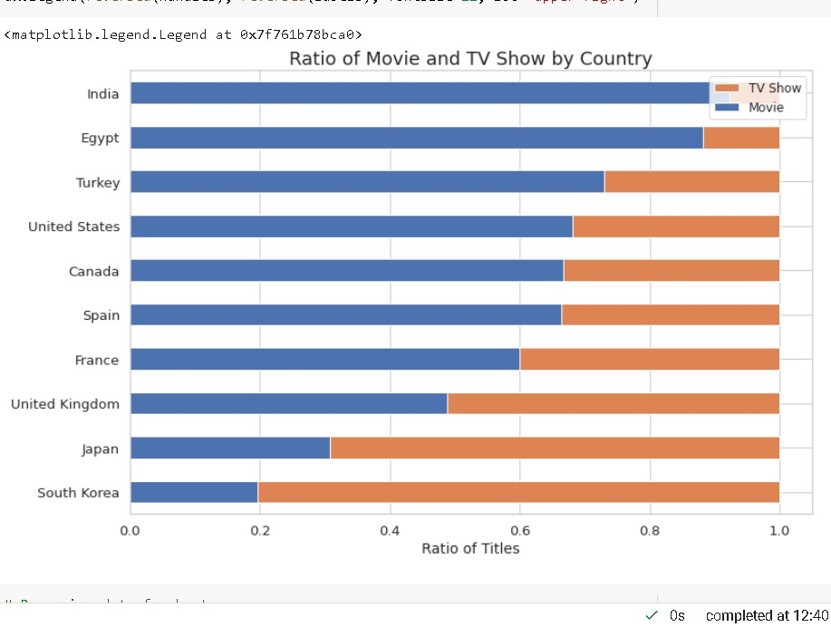
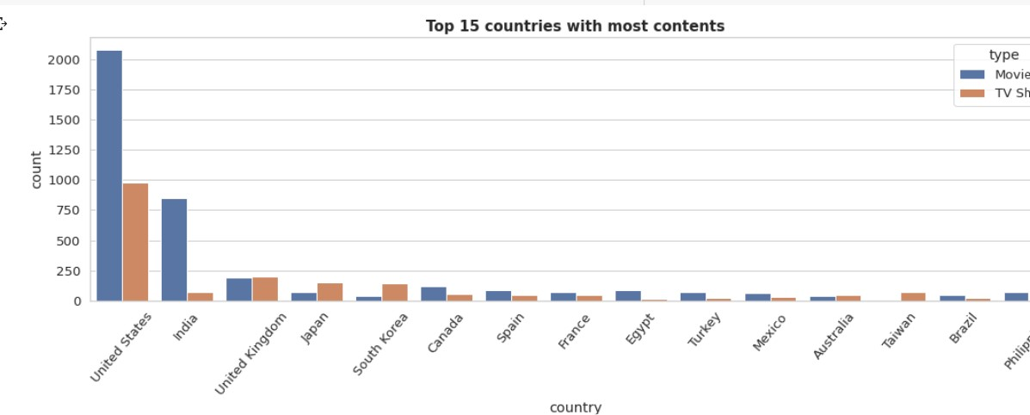
Data Vizualization, Storytelling & Experimenting with charts
Chart-7:
Based on the given information, we can say that the United States has the highest number of content on Netflix, followed by India. Additionally, India has the highest number of movies on Netflix.
India has the highest number of movies on Netflix.

Slide 20
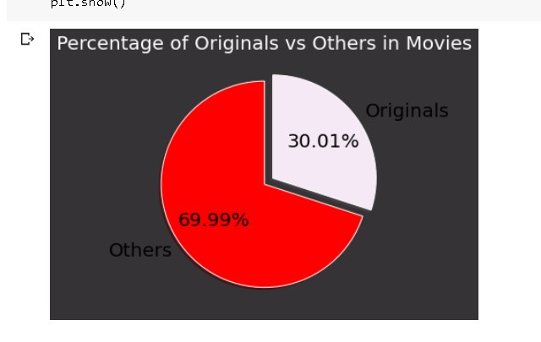
Data Vizualization, Storytelling & Experimenting with charts
Chart-8:
The percentage of originals vs others.
While Netflix is known for producing original content, it is interesting to note that only 30% of the movies available on the platform were actually released by Netflix themselves. The remaining 70% of movies were added to Netflix after being released by different modes, such as theaters or other streaming platforms.

Slide 21
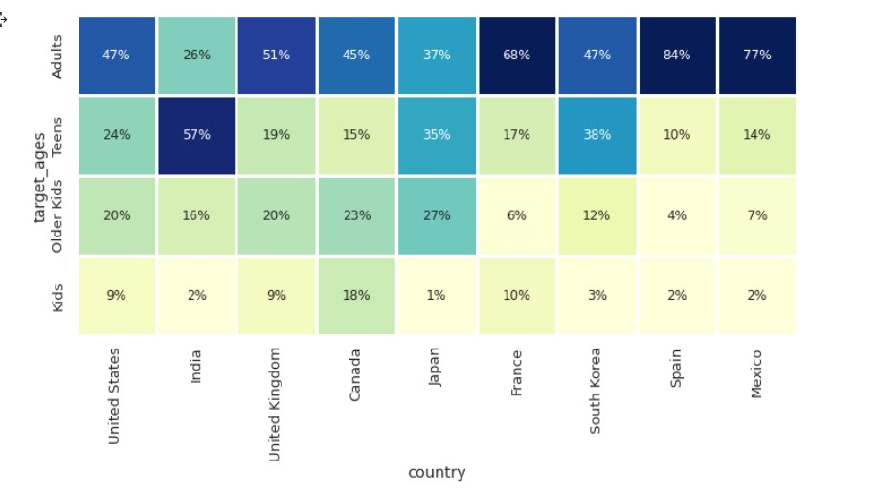
Data Vizualization, Storytelling & Experimenting with charts
Chart-9:
The relation between variables.
the US and UK are closely aligned with their Netflix target ages, but radically different from, example, India or Japan!
Also, Mexico and Spain have
similar content on Netflix for
different age groups.

Slide 22
Hypothesis Testing
I used a two-sample t-test (also known as an independent samples t-test or unpaired t-test) to obtain the p-value. Specifically, I used the ttest_ind function from the scipy.stats module to perform the t-test. This test is appropriate for comparing the means of two independent samples, which is what we're doing here by comparing the number of movies on Netflix in the United States and India.
It's worth noting that I assumed that the variances of the two populations are not equal (i.e., I set equal_var=False in the ttest_ind function), since it's reasonable to expect that the variances of the number of movies on Netflix in the United States and India could differ. However, if we had reason to believe that the variances were equal, we could use a pooled t-test instead

Slide 23
To obtain the p-value, we have performed a chi-square test for independence. The chi-square test is used to determine if there is a significant association between two categorical variables. In this case, we wanted to test if there was a significant association between the time of year and the number of new movies and TV shows added to Netflix. The test involves comparing the observed frequencies of the contingency table (which shows the distribution of the data) to the expected frequencies under the assumption of independence.
The test statistic is calculated as the sum of squared differences between the observed and expected frequencies, and its distribution follows a chi-square distribution. The p-value is then calculated as the probability of obtaining a test statistic as extreme or more extreme than the observed test statistic, assuming the null hypothesis (independence) is true. If the p-value is less than the significance level (usually 0.05), we reject the null hypothesis and conclude that there is a significant association between the two variables.

Slide 24
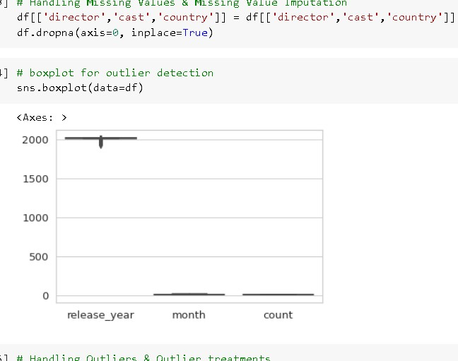
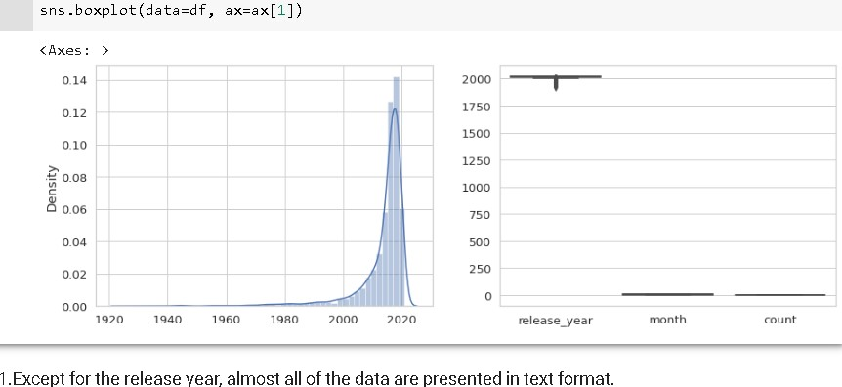
Feature Engineering & Data Pre-processing
1.Except for the release year, almost all of the data are presented in text format.
2.The textual format contains the data we need to build a cluster/building model. Therefore, there is no need to handle outliers.

Slide 25
Dimesionality Reduction
We can use PCA (Principal component Analysis) to reduce the dimensionality of data.
Dimensionality reduction is the process of reducing the number of features or dimensions in a dataset while preserving as much information as possible. It is a common step in machine learning and data analysis, as high-dimensional datasets can be difficult to work with and can sometimes suffer from the curse of dimensionality.

Slide 26
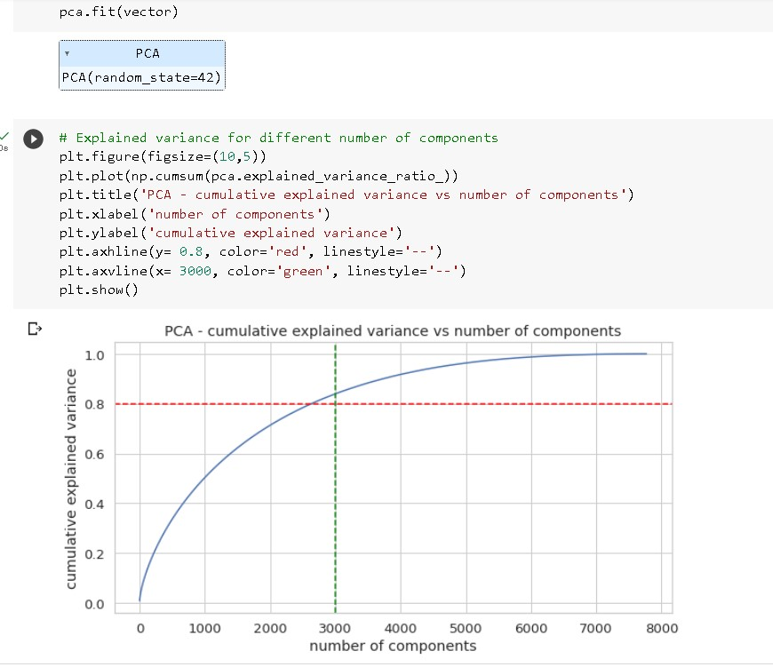
Dimesionality Reduction
We find that 100% of the va*riance is explained by about ~7500 components.
Also, more than 80% of the variance is explained just by 3000 components.
Hence to simplify the model, and reduce dimensionality, we can take the top
3000 components, which will still be able to capture more than 80% of variance.

Slide 27
K-Means Clustering
K-means clustering is an unsupervised machine learning algorithm that is used to divide a dataset into a specified number of clusters. It is called "unsupervised" because the algorithm does not use any labeled examples to learn about the data. Instead, it relies on the inherent structure of the data to group the samples into clusters.
How It's Work?
The k-means algorithm works by first selecting k initial "centroids," or cluster centers, at random from the data. Then, it assigns each sample in the dataset to the nearest centroid, based on some distance metric like Euclidean distance. The algorithm then updates the centroids to be the mean of the samples in each cluster. teratively repeats the process of reassigning samples to the nearest centroids and updating the centroids until convergence. Visualizing the elbow curve and Silhouette score to decide on the optimal number of clusters for K-means clustering algorithm

Slide 28
Hierarchical clustering
After applying the agglomerative hierarchical clustering algorithm, the resulting clusters are displayed in a dendrogram, which is a tree-like structure. The dendrogram shows the relationships between the clusters at each level of the hierarchy.
To determine the optimal number of clusters for our data, we can visually inspect the dendrogram and look for the largest vertical distance that does not intersect any horizontal line. This distance represents the largest distance between any two merged clusters, and thus the point at which the clusters are most dissimilar.
We can then draw a horizontal line at this distance and count the number of vertical lines it intersects. This number corresponds to the optimal number of clusters for our data.

Slide 29
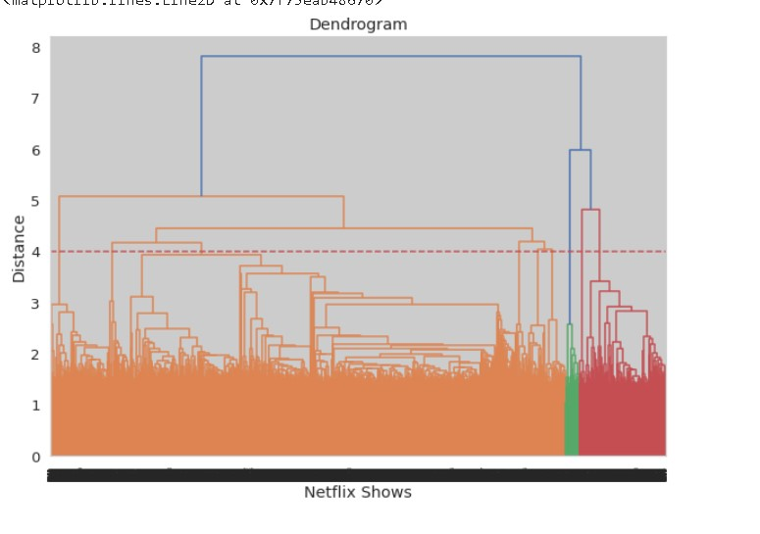
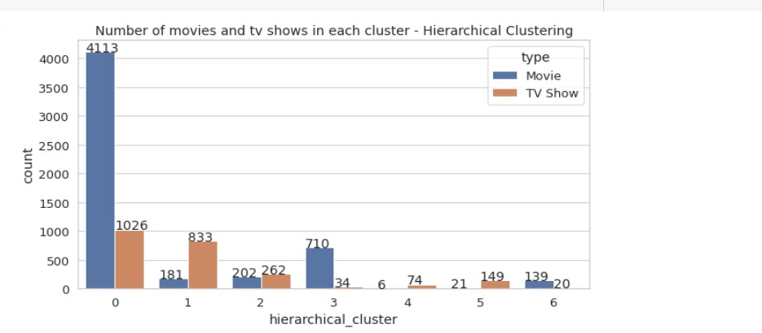
At a distance of 4 units, 7 clusters can be built using the agglomerative clustering algorithm.
Successfully built 7 clusters using the Agglomerative (hierarchical) clustering algorithm.

Slide 30
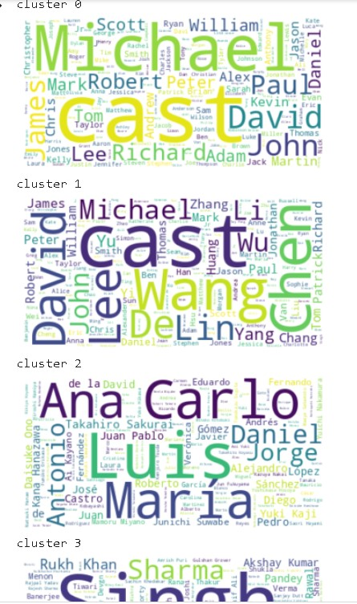
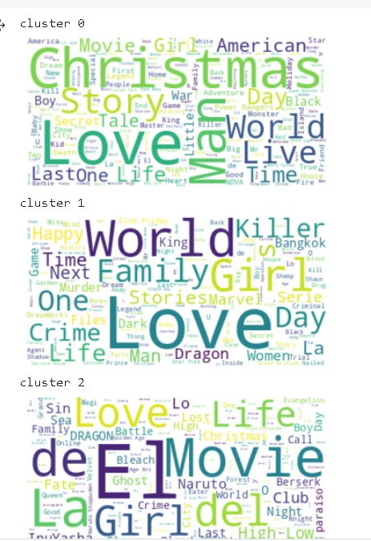
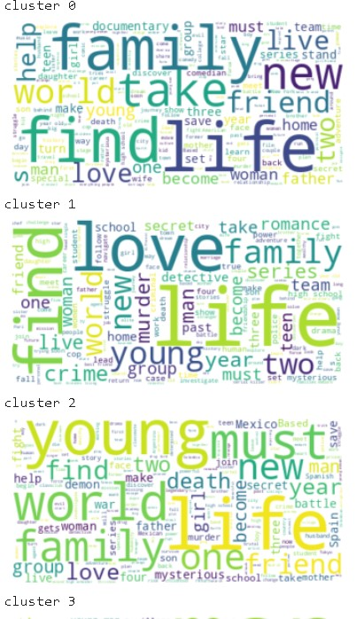
Word Cloud on “title“, ”Description”, ”Cast” column for different cluster

Slide 31
Conclusion
Welcome to our exciting journey of exploring the world of Netflix shows! Our goal was to cluster the shows into groups based on their similarities and differences, ultimately creating a content-based recommender system that suggests 10 shows based on the user's viewing history.
With over 7787 records and 11 attributes, we began our adventure by delving into the dataset's missing values and performing exploratory data analysis (EDA). Our findings revealed that Netflix boasts more movies than TV shows, with a rapidly growing collection of shows from the United States.
To cluster the shows, we focused on six key attributes: director, cast, country, genre, rating, and description. We transformed these attributes into a 10000-feature TFIDF vectorization, then used Principal Component Analysis (PCA) to tackle the curse of dimensionality. By reducing the components to 3000, we were able to capture more than 80% of the variance.
Next, we used two clustering algorithms, K-Means and Agglomerative clustering, to group the shows. K-Means determined that the optimal number of clusters was 5, as confirmed by the elbow method and Silhouette score analysis. Meanwhile, Agglomerative clustering suggested 7 clusters, which we visualized using a dendrogram.

